Slide 1
DAIRY MANAGEMENT SYSTEM
Submitted by:
Swapnil Rohidas Tawhare
Sampada Dnyandev Shinde

Slide 2
INDEX
Introduction
Observations
Proposed work : Tools/Platform and Languages
Project Scope
Limitations of Existing system
Benefits and Limitations of dairy management
ER Diagram
Future Scope
Conclusion
References

Slide 3
INTRODUCTION
The mission of the Milk Production House Project is to create to communication between rural area people and dairy management.
Our main goal to develop this application to encourage a dairy industry.
DAIRY MILK MANAGEMENT SYSTEM is a software application to maintain day-to-day transactions in a Milk Distributor Office.
This software help to register all the suppliers, buyers details , purchase and sails details etc.,
This project is beneficial for new Milk Distributor to be start soon in the city.
They have big plan to collect the milks from many different sources and distribute the same for the Milk buyers.
To manage all these the required a full-fledged software which will take care all these.

Slide 4
Proposed work : Tools/Platform and Languages
For Server Side :-
Minimum Hardware Requirement :
Processor 1.60GHz
RAM 512 MB
Hard Disk 40 GB
Languages:
Operating System: Windows /Linux
Database: MySQL
Programming Language: Java
For Client Side:-
Minimum Hardware Requirement
Processor 1.60GHz
RAM 512 MB
Hard Disk 40 GB
Operating System Window XP or any Compatible Operating System
Browser Internet Explorer 6.0 or any Compatible browser

Slide 5
PROJECT SCOPE
Rural area people to give survive option.
Project provide regular basis salary.
Daily Inventory manage option.
Print Detail and report
Print receipt
Quick access of all records and details.

Slide 6
Limitations of Existing system
Time consuming
Paper work
Storage requirements
Less Accuracy
Difficulty in keeping new records

Slide 7
Benefits and Limitations of dairy management system
Limitations :-
Require Light Connection.
Computer must required.
Operator has good command on English and computer.
Benefits:-
Rural Area people Survive option.
Paperwork Reduction.
Improved Data Quality.
Reduce Transportation Expensive.
View Report daily basis.
Error Reduction

Slide 8
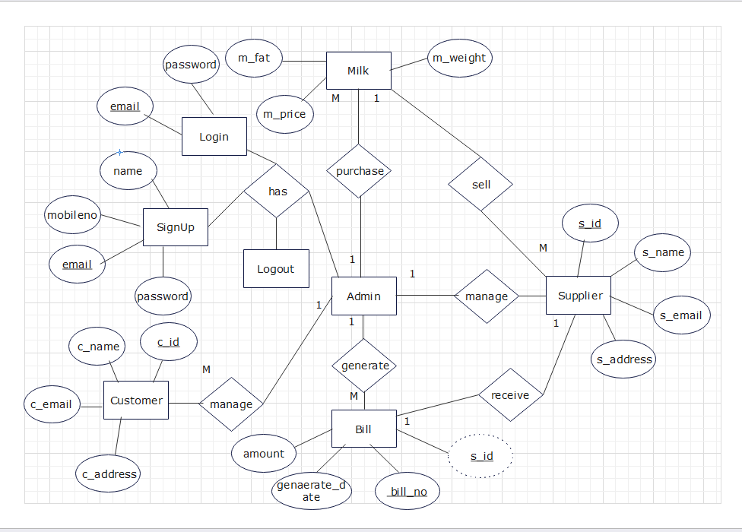
ER Diagram:-

Slide 9
Future Scope
Rural area people to give survive option.
Project provide regular basis salary.
Daily Inventory manage option.
Print Detail and report
Print receipt
Quick access of all records and details.

Slide 10
Conclusion
The Dairy Management System offers a practical and affordable solution for small dairy industry to streamline operations and improve efficiency. While it may lack some advanced features found in larger systems, it provides essential functionalities tailored to the needs of shopkeepers, enabling them to manage big dairy industry, process sales, and serve customers more effectively. Customer payment record was most important to maintain Properly such as who paid, when paid, How paid, how much paid, their outstanding amount, their paid amount etc… Suppose we have to see every customer payment status then it is more difficult to collect a kind of records. same as this many tasks are also available such as sales record, purchase record etc., so in manual system records maintain processes are more difficult. With the use of this project store can maintain their customer records easily.

Slide 11
References
www.JavaTPoint.com
www.GeeksforGreeks.com
www.W3School.com
www.tutorialspoint.com

